Slide 1
Opponents’ Rebuttal
Slate School Community Support Analysis
Dated August 18, 2021

Slide 2
Opponents’ Rebuttal of Community Support
The applicant’s Community Support Analysis consists of much misleading and incorrect information
The applicant is trying to divert the Commission’s attention from the zoning issues by understating the number of opponents and over-stating the amount and type of support they have:
  These hearings are neither a popularity contest, nor a vote
  Most people who support this project (58% on average) do so because they think Slate School is a good school
  Many supporters (67) have a vested interest, or personal connection to the school
  These supporters will feel the same way regardless of where the school is built
  Over 3-times as many people living within 1-mile of the proposed site oppose the project than support it
  There are 2-times as many opponents within the Blue Hills area than supporters
  72% of opponents live within 2-miles of the site; 60% of supporters live 2-6 miles from the site
  The opinions of people who don’t live near the site, or who have vested interests in having this project approved, should not count as much as the opinions of the opponents who live near the site and will be negatively impacted by this project
Our analysis follows

Slide 3
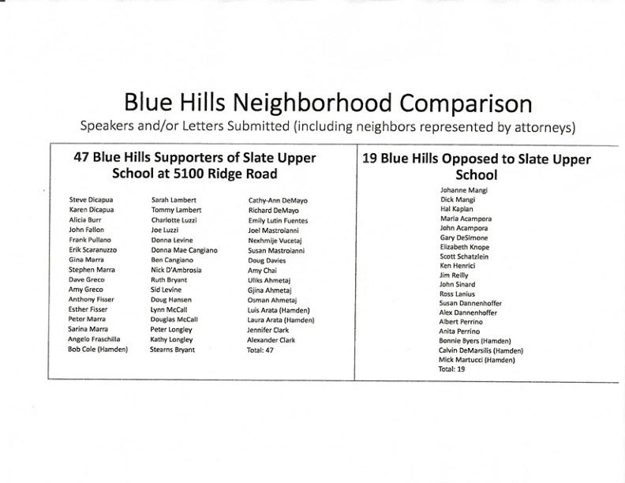
Opponents’ Rebuttal of Community Support
Page 1 – Blue Hills Neighborhood
The Applicant Conveniently Only Counted Opponents Who Live on Ridge Road Between Mt. Carmel Avenue and Blue Hills Road! Who are they kidding?

Slide 4
Opponents’ Rebuttal of Community Support
Page 1 – Blue Hills Neighborhood
4 of the supporters shown on Page 1 of the Applicant’s analysis do not appear to live in North Haven, let alone in the Blue Hills Area (Doug Davies, and (3) members of the Ahmetaj family)
Opponents in the Blue Hills Area outnumber supporters 86-to-43, or by a factor of 2
Opponents living within 1-mile of the proposed site outnumber supporters 77-to-24, or by 3.2x

Slide 5
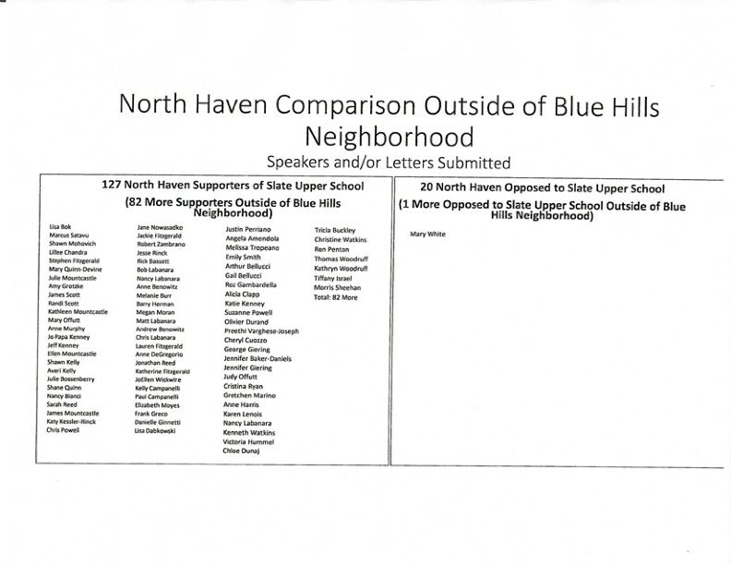
Opponents’ Rebuttal of Community Support
Page 2 – North Haven Outside of Blue Hills Neighborhood
The Applicant is Grossly Under-Stating the Number of Opponents Who Live in North Haven, Outside of the Blue Hills Neighborhood

Slide 6
Opponents’ Rebuttal of Community Support
Page 2 – North Haven Outside Blue Hills Neighborhood
1 of the supporters shown on Page 2 of the Applicant’s analysis is a duplicate (Nancy Labonara - removed), and 2 of these supporters (Barry Herman and Justin Perriano) do not appear in the North Haven GIS
There are 124 supporters in North Haven, 43 in the Blue Hills area and 81 outside of Blue Hills
There are 88 opponents in North Haven, 58 in the Blue Hills area and 30 outside of Blue Hills
Most importantly, opponents living within 1-mile of the proposed site outnumber supporters 77-to-24, or by 3.2x

Slide 7
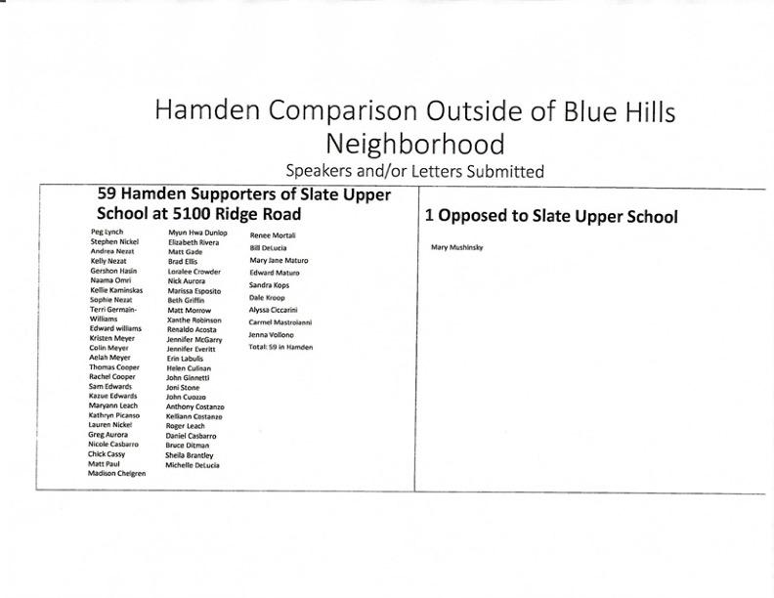
Opponents’ Rebuttal of Community Support
Page 3 – Hamden Outside of Blue Hills Neighborhood
The Applicant is Grossly Under-Stating the Number of Opponents Who Live in Hamden, Outside of the Blue Hills Neighborhood

Slide 8
Opponents’ Rebuttal of Community Support
Page 3 – Hamden Outside Blue Hills Neighborhood
There are 14 supporters listed as living in Hamden who do not appear in the Hamden GIS or the White Pages
There are 59 supporters in Hamden, outside of Blue Hills
There are 32 opponents in Hamden, outside of Blue Hills
But, most of these supporters live miles away from the proposed site, as the next pages show

Slide 9
Opponent’s Rebuttal to Community Support
There are as many total opponents as supporters in Hamden
Supporter John Cuozzo was counted in Hamden; his office is in Hamden, but his home is in North Haven [he is shown below as No Haven (X)]
47 Hamden opponents (78%) live within 2-miles of the proposed site; only 7 supporters (12%) do

Slide 10
Opponent’s Rebuttal to Community Support
Where do the Supporters Live in Hamden & North Haven?
106 opponents (72%) live less than 2-miles from the proposed site. We are not counting 17 opponents who live outside of the North Haven/Hamden area
109 supporters (60%) live between 2-6 miles from the proposed site (not counting Unknowns). Their opinions should not count as much as the opinions of the 106 opponents who live near the site

Slide 11
Opponents’ Rebuttal of Community Support
Why Do Neighbors Support the High School Project?
An overwhelming number support the high school because they think the Lower School is a good school
This is irrelevant to this Commission’s decision.

Slide 12
Opponents’ Rebuttal of Community Support
Many Supporters Have a Relationship with Slate School
67 supporters in this latest analysis support the high school because they have a vested interest in having it approved because of their relationships with Slate School
One family (Di Capua) just sold their property at 103 Kings Hwy to Slate School for almost twice market value!
The opinions of these supporters with vested interests should not count as much as the opinions of opponents who will be negatively impacted by this project

Slide 13
Opponents’ Rebuttal of Community Support
Closing Summary
The applicant is over-stating the level of support for this project
  Within 1-mile of the site, 3.2-times more people oppose the project than support it
  Within the overall Blue Hills neighborhood, 2-times as many people oppose the project as support it
  106 opponents (72%) live less than 2-miles from the site; 109 supporters (60%) live much further away - between 2-6 miles from the site
  57.6% of the supporters do so because they feel the Lower School is a good school; this is irrelevant
  67 supporters have a relationship with the Lower School; vested interests are irrelevant
The decision to approve this application is neither a popularity contest nor a vote.
  The opinions of people who don’t live near the site, or who have vested interests in having the project approved, should not count as much as the opinions of the opponents who live near the site and will be negatively impacted by this project
We urge the Commission to look beyond the inflated and misleading claims of support and deny this application

